Slide 1
Multi-dim Node-Specific Graph Neural Architecture Search for Distribution Shift
2252090 王麒懿, 2250420 陈君, 2250758 林继申
2025年6月20日

Slide 2

01
Introduction
02
Methodology
CONTENTS
03
Experiments
04
Conclusion

Slide 3
1
Introduction

Slide 4
Background
Why Rethink GNN Design?
GNNs Excel in tasks like graph classification, partitioning, and community detection — thanks to their message passing capabilities.
But Their Power Has a Cost: GNNs rely heavily on local neighborhood aggregation, making them sensitive to graph structure.
Problem: This structural dependence can cause severe performance degradation when the test data distribution differs from the training graph — a phenomenon known as distribution shift or Out-of-Distribution (OOD).
Introduction
Methodology
Experiments
Conclusion

Slide 5
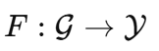
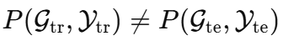
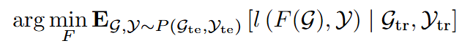
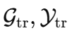
Problem Definition
What is Out-of-Distribution (OOD) Generalization?
Training vs. Test Distribution: In real-world scenarios, the test graphs often differ significantly from the training graphs in structure, size, or semantics.
Goal: Learn a model
that performs well on unseen test graphs
even when
Formal Objective:
under the constraint: only access to
Introduction
Methodology
Experiments
Conclusion

Slide 6
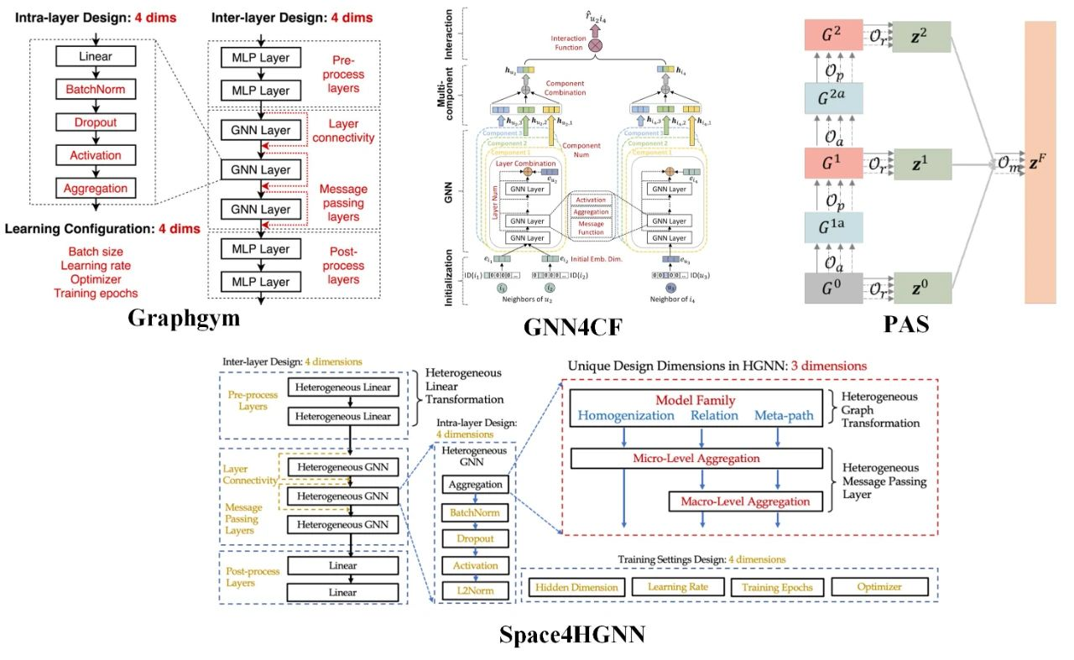
GraphNAS
What is Graph Neural Architecture Search (GraphNAS)?
Introduction
Methodology
Experiments
Conclusion

Slide 7
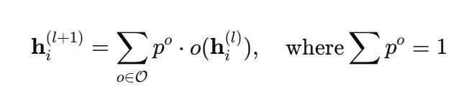
GraphNAS
What is GraphNAS?
Automates GNN architecture design by searching over candidate operations.
Early methods use black-box search in discrete space, suitable only for IID datasets.
Recent methods adopt differentiable architecture search with soft selection and weight sharing.
Performs well under distribution shifts by assigning different architectures to different graphs.
Key Formula:
Introduction
Methodology
Experiments
Conclusion

Slide 8
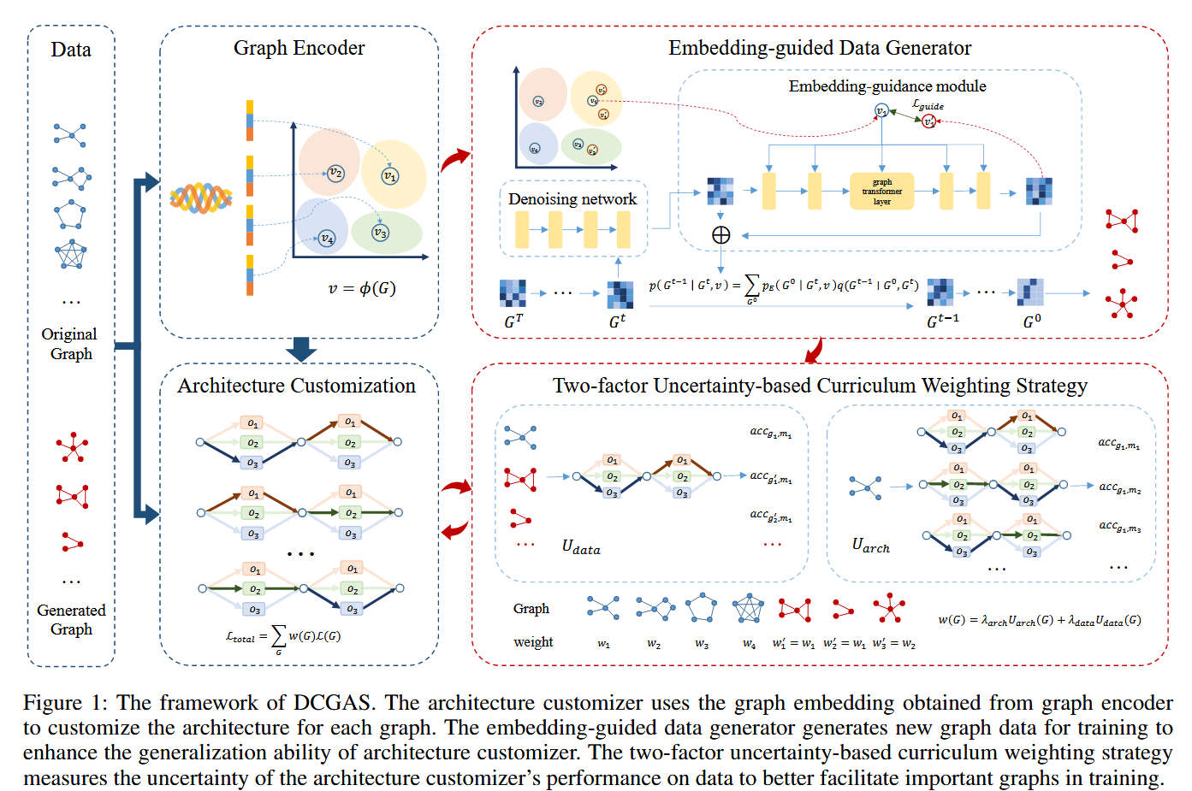
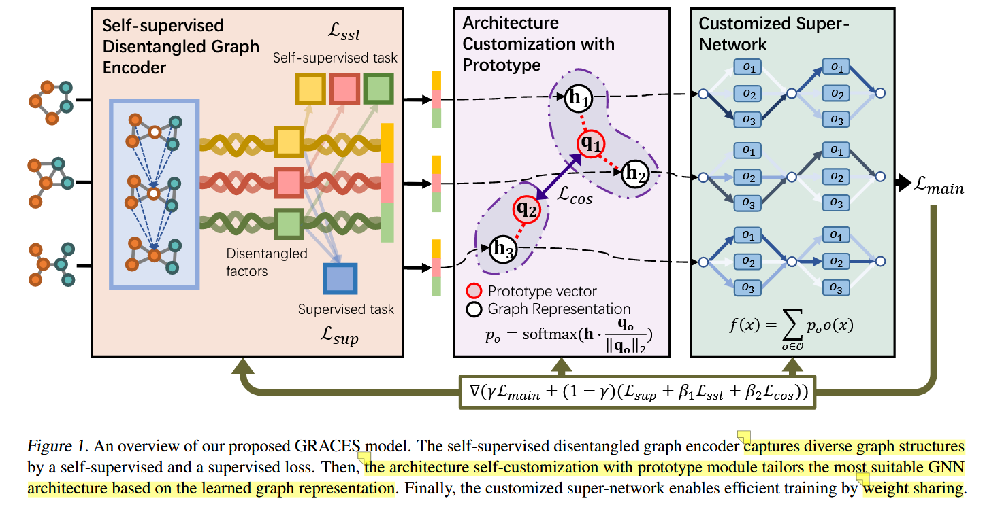
GraphNAS
Introduction
Methodology
Experiments
Conclusion

Slide 9
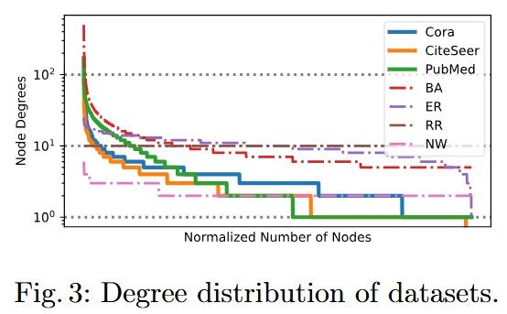
Limitations
Limitations of GraphNAS
Still relies on large-scale training data to learn graph-architecture mappings.
Struggles when training on sparse or single-graph datasets.
Assigns one architecture per graph — does not distinguish between nodes within a graph.
Ignores structural heterogeneity caused by long-tail node degree distributions.
Introduction
Methodology
Experiments
Conclusion

Slide 10
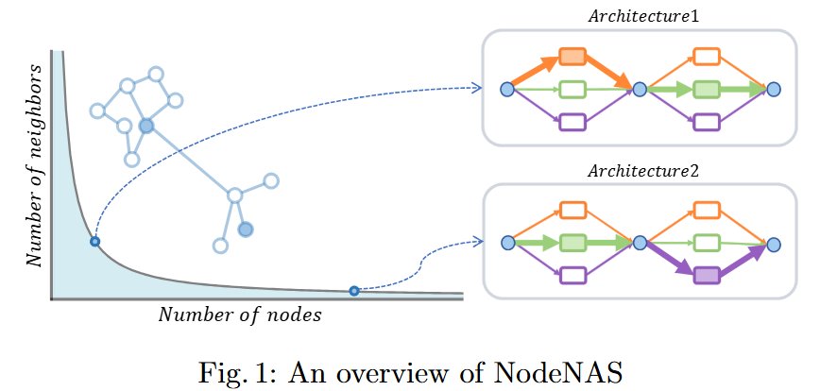
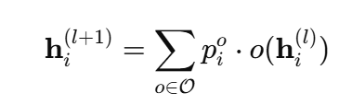
NodeNAS
NodeNAS: Node-Specific Architecture Search
Instead of applying the same aggregation method to all nodes, NodeNAS customizes GNN architectures per node.
Learns a unique probability vector for each node, selecting candidate operations dynamically.
Addresses node-level heterogeneity (e.g., long-tail degree distributions) across different graph types.
Facilitates OOD generalization by decoupling node degree patterns from global graph distribution.
Per-node aggregation formula:
Introduction
Methodology
Experiments
Conclusion

Slide 11
2
Methodology

Slide 12
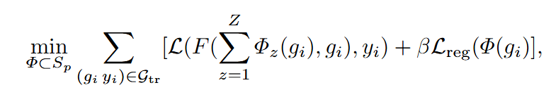
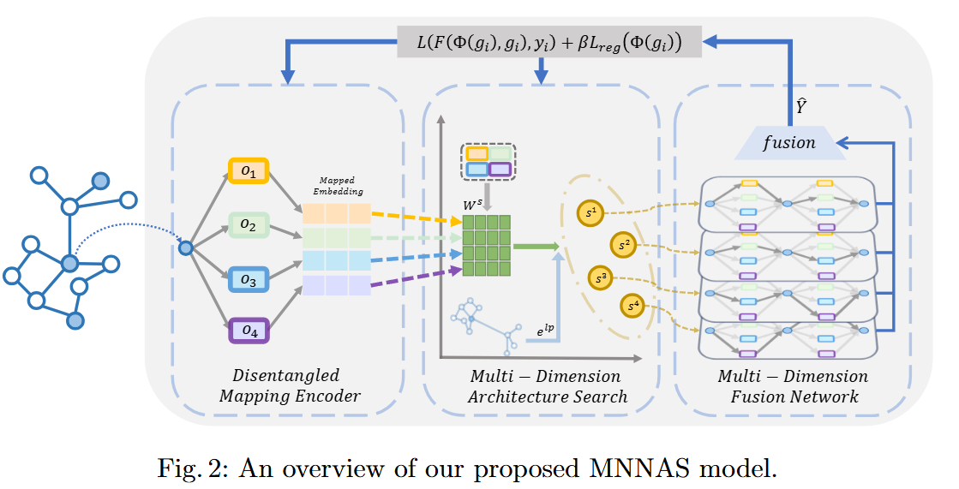
Framework
Multi-dim Node-Specific Graph Neural Architecture Search (MNNAS)
Introduction
Methodology
Experiments
Conclusion

Slide 13
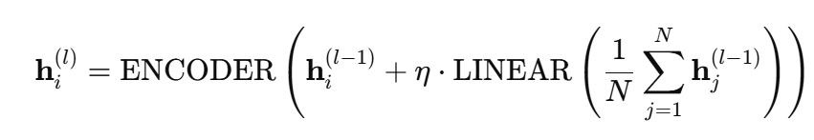
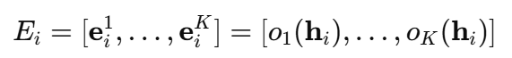
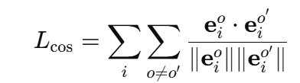
Encoder
Disentangled Mapping Encoder
Injects global context by combining local features with graph-wide averages:
Maps each candidate operation to a learnable node-specific embedding:
Shared mapping across all search dimensions (S-Dims) ensures efficiency.
Applies cosine regularization to preserve diversity:
Introduction
Methodology
Experiments
Conclusion

Slide 14
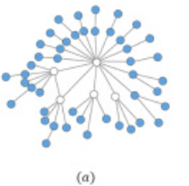
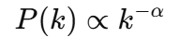
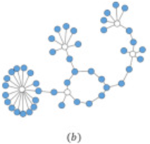
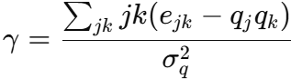
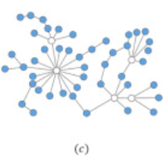
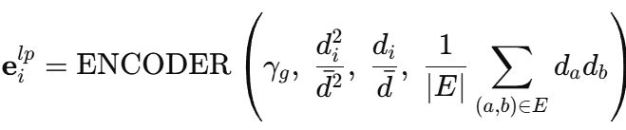
Architecture Search
Multi-Dim Architecture: Link Pattern Encoder
Motivation: Generalizing to OOD graphs requires modeling both node-level structure and global graph properties.
Power Law Distribution:
High-degree hubs vs. long-tail nodes require different aggregation strategies.
Assortativity: Measures how similar connected nodes are in degree:
Encoder Input:
Introduction
Methodology
Experiments
Conclusion

Slide 15
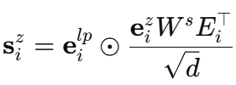
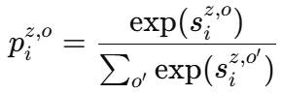
Architecture Search
Multi-Dim Architecture: Adaptive Aggregation Attention
For each node i in S-Dim, compute operation preferences:
Use softmax to get probabilities over candidate operations:
Attention mechanism aligns operation selection with topological context, guided by link pattern vector.
Introduction
Methodology
Experiments
Conclusion

Slide 16
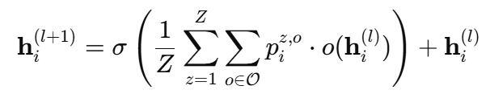
Fusion Network
Multi-Dimension Fusion Network
Aggregates node-specific architectures across all search dimensions (S-Dims) to build final node representation.
Fusion Formula:
Uses residual connection to preserve identity and reduce overfitting.
Thanks to shared embedding mapping avoids redundant operation computation.
No architecture discretization or retraining — supports end-to-end weight sharing.
Introduction
Methodology
Experiments
Conclusion

Slide 17
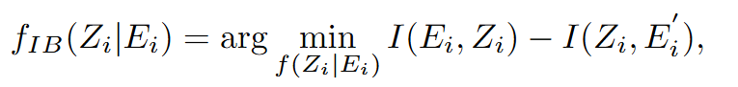
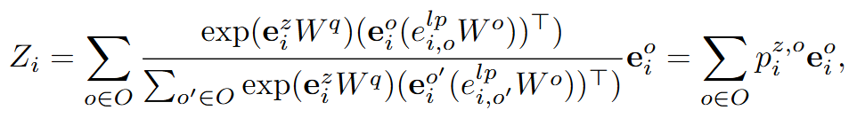
Theoretical Insights
Theoretical Analysis Through Information Bottleneck Theory
It aims to find the most concise and effective data representation, that is, to retain the most valuable information by sacrificing some irrelevant information.
Introduction
Methodology
Experiments
Conclusion

Slide 18
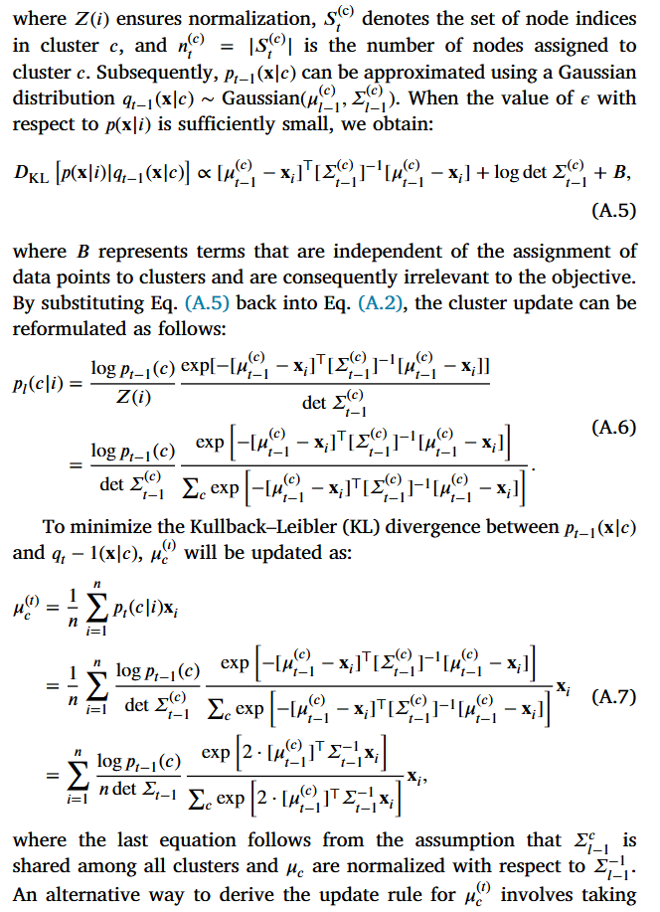
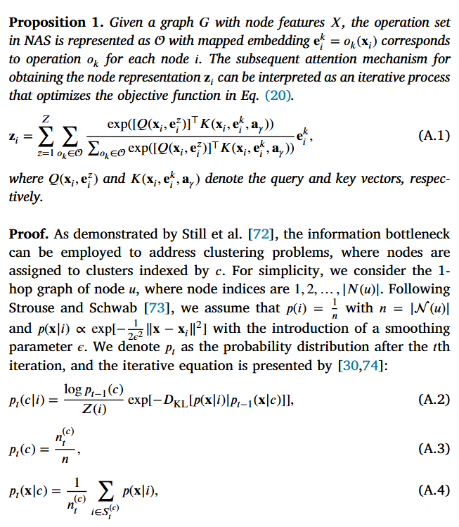
Theoretical Insights
Introduction
Methodology
Experiments
Conclusion

Slide 19
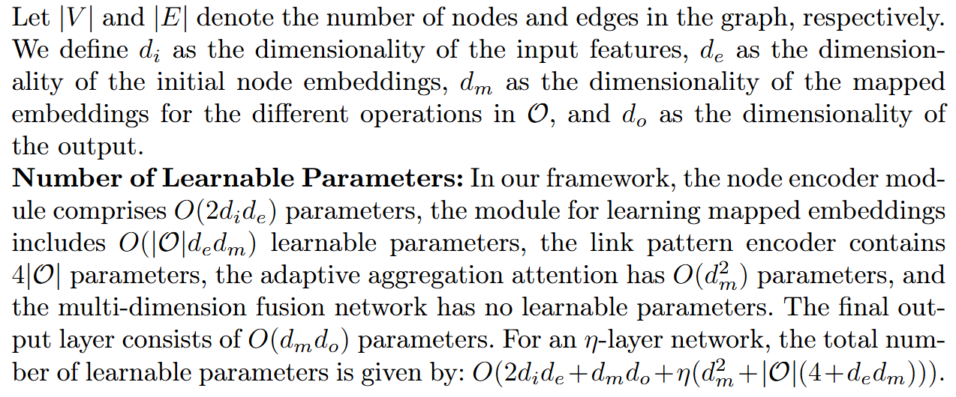
Complexity Analysis
Introduction
Methodology
Experiments
Conclusion

Slide 20
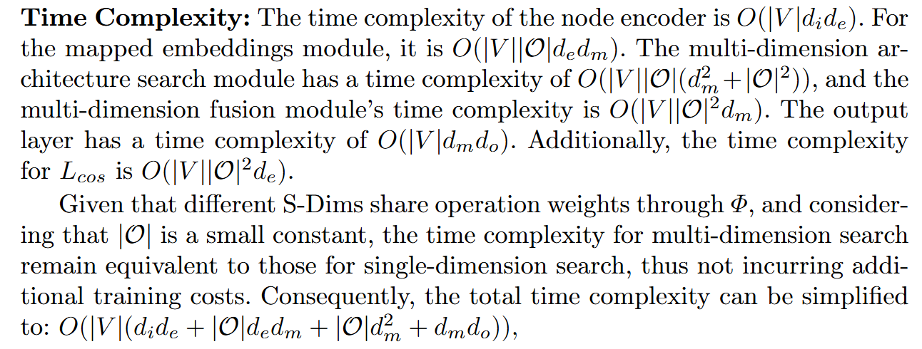
Complexity Analysis
Introduction
Methodology
Experiments
Conclusion

Slide 21
3
Experiments

Slide 22
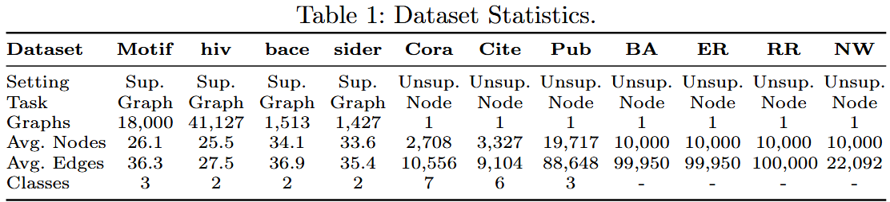
Setting
Experimental Setup
Goal: Evaluate MNNAS under distribution shifts across
➤ Supervised graph classification ➤ Unsupervised community detection ➤ Inverse graph partitioning
Baselines
Hand-designed GNNs: GCN, GAT, GIN, GraphSAGE, GraphConv, GAP, ClusterNet, ASAP, DIR, PNA, GSAT
NAS-based Methods: DARTS, GraphNAS, PAS, GASSO, GRACES, DCGAS (SOTA)
Introduction
Methodology
Experiments
Conclusion

Slide 23
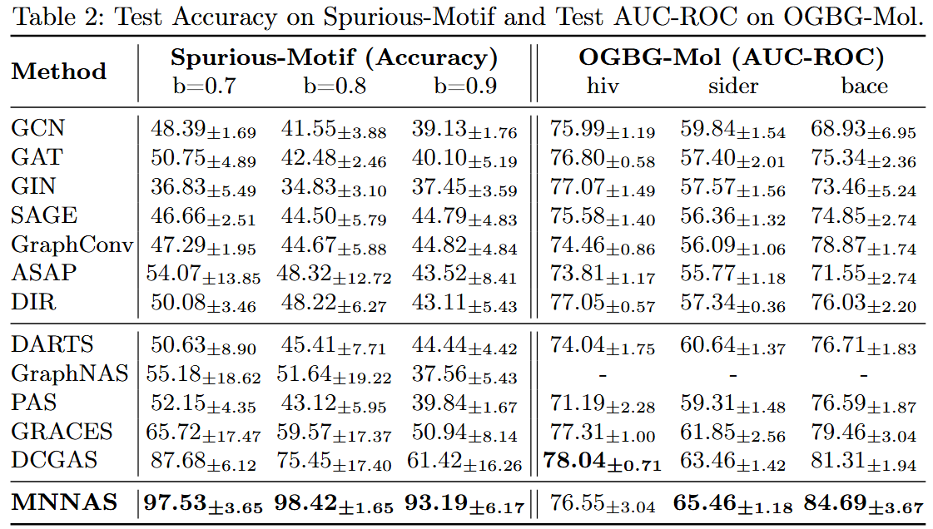
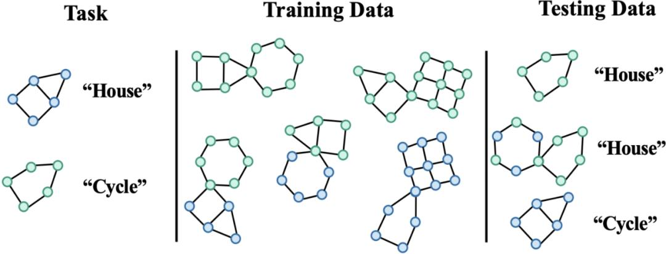
Graph Classification
Introduction
Methodology
Experiments
Conclusion

Slide 24
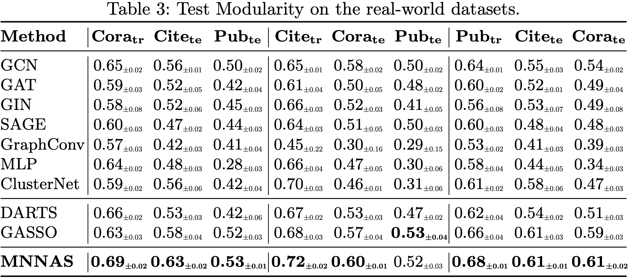
Community Detection
Introduction
Methodology
Experiments
Conclusion

Slide 25
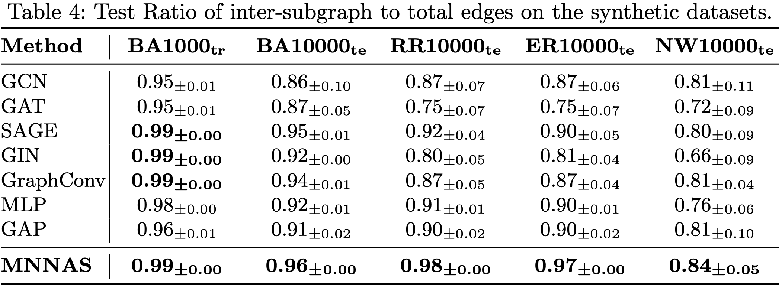
Inverse Graph Partition
Introduction
Methodology
Experiments
Conclusion

Slide 26
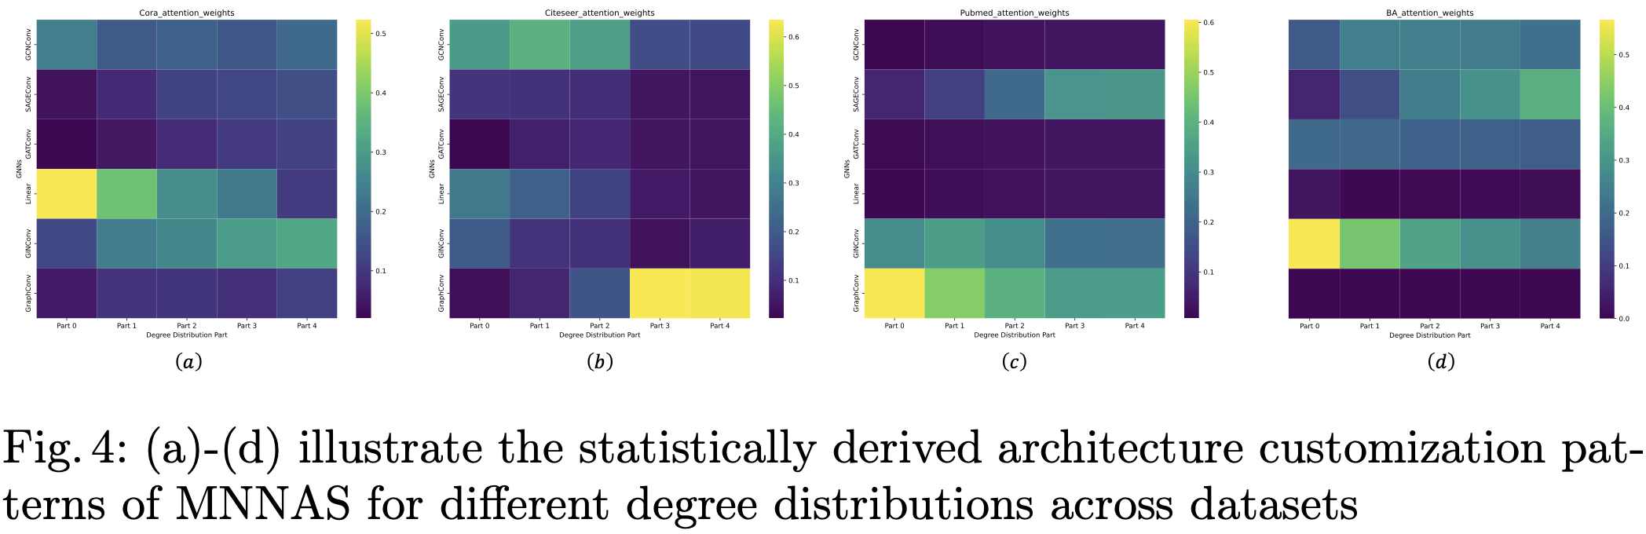
Interpretability
Introduction
Methodology
Experiments
Conclusion

Slide 27
3
Conclusion

Slide 28
Conclusion
MNNAS introduces node-specific architecture search, allowing each node to select its own aggregation strategy — adapting flexibly to structural diversity within and across graphs.
Incorporates adaptive aggregation attention, disentangling power-law degree and assortativity patterns to guide multi-dimensional architecture search.
Achieves strong OOD generalization, even under limited or single-graph training — a first in GraphNAS literature.
Validated across supervised and unsupervised tasks, demonstrating consistent improvements over state-of-the-art GNNs and NAS methods on challenging distribution-shift benchmarks.
Introduction
Methodology
Experiments
Conclusion

Slide 29
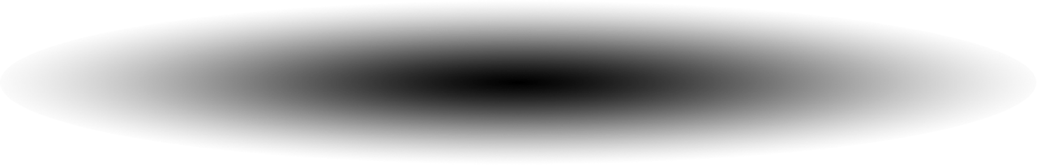
Thank you!
2252090 王麒懿, 2250420 陈君, 2250758 林继申
2025年6月20日

